Slide 1
Introduction to github
YAWIC Lunchtime Session 1

Slide 2
tinyurl.com/yawic-sessions
Follow this link

Slide 3

CONTENTS
Create Github account
What is Git?
How does Git work?
What is Github?
How to use Git and Github

Slide 4
Create Github Account

Slide 5
www.github.com
Free for public repositories (students get free unlimited private repositories as well
Sign up at: https://education.github.com/pack

Slide 6
What is git?

Slide 7
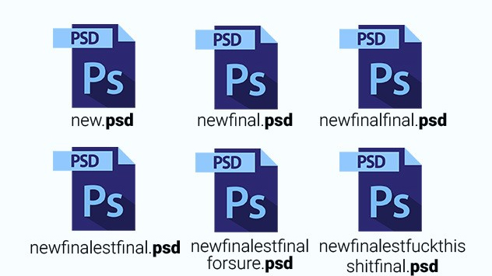

Slide 8
What is version control
A system that keeps track of changes in a project
Allows for collaborative development (distributed version control system)
Lets you know who made changes and when
Allows you to revert any changes and go back to a previous state

Slide 9

What is git
Git is an open source distributed version control system
Allows you to keep history of versions and make changes on local machine storage
Push and Pull can only be done when connected to remote storage

Slide 10
How does git work?

Slide 11
How git works
A system that keeps track of changes in a project
Allows for collaborative development (distributed version control system)
Lets you know who made changes and when
Allows you to revert any changes and go back to a previous state

Slide 12
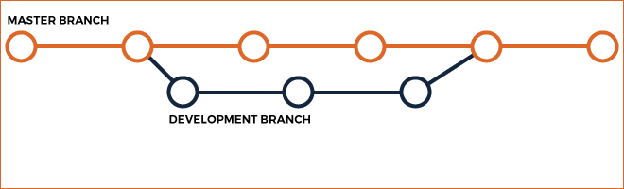
How git works
You take a snapshot of your work to record what your files look like at any time.
You have the ability to visit any snapshot at any point

Slide 13
Common Git Commands
Add – creates a new repository
Commit – saves a snapshot of your repository
Push – Adds commits to a remote storage location
Pull – Collects all commits from a remote storage
Branch – Create a copy of your repository and all commits separate from the ‘master’ branch
Merge – Combine commits from different branches
https://confluence.atlassian.com/bitbucketserver/basic-git-commands-776639767.html

Slide 14
What is Github?

Slide 15

What is Github?
Github is a git client and community where people store remote repositories (mostly code) and collaborate.

Slide 16



Other Git Clients and services

Slide 17
Common Github terms
Fork (forking a repository) – Making a copy of a repository with your account
Pull request – Request that your changes in a branch (or fork) be added to a repository

Slide 18
What github adds to git
Allows you to use a GUI instead of command line
Adds a social element to coding

Slide 19
Why you should use github
Version control
Backup your code
Can easily be shared
Can collaborate with people from all over the world
Can contribute to other people’s projects (open source)

Slide 20
How to use git and github

Slide 21
Your first commit
Go to https://github.com/LadySith/HelloMandelaCS
Fork repository (creates a new branch in your account)
Add your name to README.md
Make a pull request
If accepted, your pull request will be merged to the main code
Done!

Slide 22
FIN

